Slide 1
Harine P

Slide 2
PROJECT TITLE
Fake News Detection Using Machine Learning

Slide 3

AGENDA
Understanding the Problem:
Analyze datasets to comprehend fake news dynamics and influential factors.
2.Data Preprocessing and Visualization:
Prepare and visualize data to uncover patterns and relationships for effective modeling.
3.Model Selection:
Identify optimal machine learning algorithms tailored for accurate fake news classification.
4.Model Training and Evaluation:
Train and assess selected models to gauge their performance in detecting fake news.
5.Results Analysis:
Compare model performances and select the most effective one for fake news detection.
6.Solution Deployment:
Deploy the chosen model for real-time identification of fake news, aiding in combating misinformation.
3/21/2024 Annual Review

Slide 4
PROBLEM STATEMENT
The project involves the proliferation of fake news, which undermines trust in media and contributes to misinformation. To combat this, the methodology involves leveraging machine learning to analyze textual features and metadata from news articles, enabling the development of accurate detection models. Addressing this problem is crucial as it preserves the integrity of information and promotes media literacy in an era of digital information overload.

Slide 5
PROJECT OVERVIEW
The Project focuses on leveraging machine learning techniques to combat the proliferation of fake news by developing a robust detection model. By analyzing textual content and metadata from news articles, social media posts, and other sources, the model aims to accurately identify misinformation. Automating fake news detection not only helps in preserving the integrity of information but also aids in enhancing media literacy and combating the societal impact of misinformation dissemination

Slide 6
WHO ARE THE END USERS?
Social Media Platforms: Utilize machine learning to detect and flag fake news, enhancing platform credibility and user trust.
News Agencies and Publishers: Implement fake news detection models to uphold the dissemination of accurate information and maintain reader trust.
Fact-Checking Organizations: Employ machine learning to automate verification processes, ensuring the dissemination of accurate information to the public.
Government Agencies: Leverage fake news detection technology to monitor online discourse and safeguard public trust and national security.
Educational Institutions: Integrate fake news detection tools into curriculums to promote critical thinking and media literacy skills among students.
Individual Users: Benefit from fake news detection tools, such as browser extensions or mobile apps, to make informed decisions and reduce susceptibility to misinformation.

Slide 7
YOUR SOLUTION AND ITS VALUE PROPOSITION
Solution:
Our machine learning-based fake news detection system employs advanced algorithms to analyze textual content, metadata, and social engagement metrics, accurately distinguishing between credible news and misinformation.
Value Proposition:
Accuracy: Our solution offers high accuracy in identifying fake news, aiding in the preservation of the integrity of information dissemination.
Efficiency: By automating the detection process, our system enhances efficiency, enabling quick identification and mitigation of fake news.
Trustworthiness: With our solution, users can trust the reliability of the information they consume, fostering confidence in online content.
Scalability: Our system is scalable and adaptable, capable of handling large volumes of data to combat the proliferation of fake news effectively.

Slide 8
THE WOW IN YOUR SOLUTION
Cutting-edge Machine Learning: Harnessing sophisticated machine learning algorithms empowers our model to discern intricate patterns and nuances in textual data, enhancing its ability to detect fake news accurately.
Swift Detection: Upon implementation, our system swiftly analyzes news articles and social media content, enabling rapid identification of misleading information in real-time, thereby curtailing its spread.
Adaptive Customization: Our model is highly adaptable and can be tailored to suit the unique needs and preferences of different organizations, ensuring seamless integration and optimized performance in combating fake news.

Slide 9
MODELLING
1.Data Preparation:
Collect and preprocess the dataset, including text cleaning, tokenization, and feature extraction.
Handle imbalanced classes and ensure data quality.
2.Model Selection:
Explore various machine learning algorithms suitable for classification tasks, including logistic regression, PassiveAggressiveClassifier, decision trees, random forests, and support vector machines.
3.Model Training:
Split the dataset into training, validation, and test sets.
Train the selected models using appropriate techniques, including cross-validation and hyperparameter tuning.
4.Model Evaluation:
Evaluate model performance using metrics such as accuracy, precision, recall, F1-score, and ROC-AUC.
Perform error analysis to understand common patterns and challenges.
3/21/2024 Annual Review

Slide 10
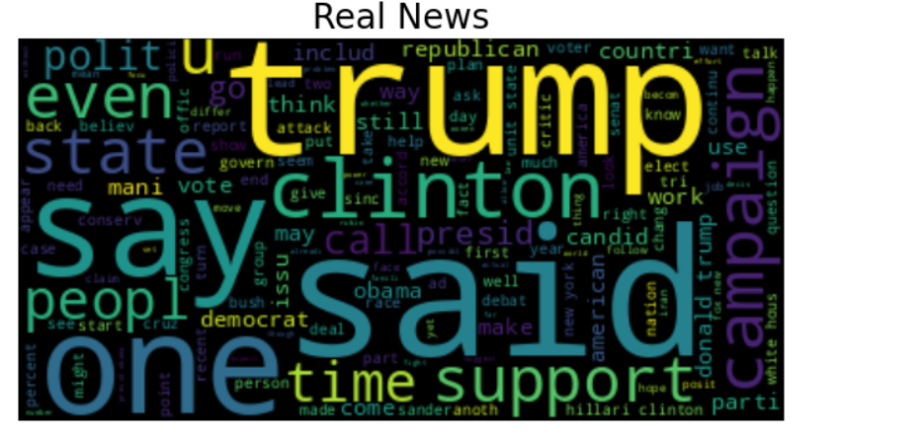
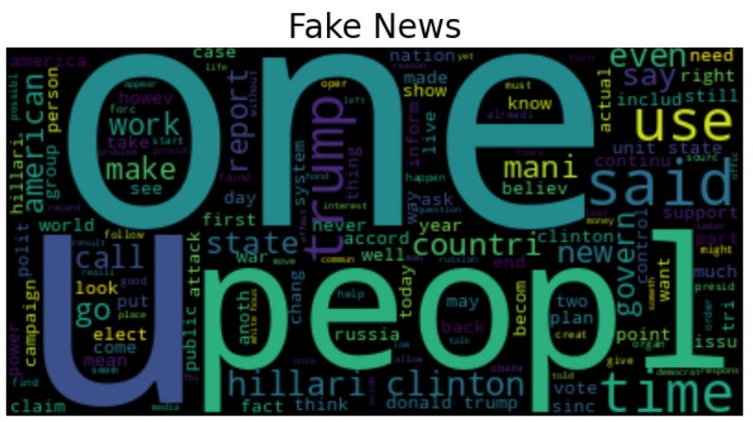
RESULTS
In summary, our project delivers a machine learning-driven fake news detection system, enhancing the ability to distinguish misinformation from credible content. This solution empowers various stakeholders to combat misinformation effectively, promoting media literacy and safeguarding the integrity of online information dissemination.

